Slide 1

Topics of today
1. NETWORK INTERFACE CARD
2. Transmission Media and topologies media
3. Crimping tools and Color standards for Straight crimping and Cross crimping

Slide 2
NETWORK INTERFACE CARD
A network interface card (NIC) is a hardware component without which a computer cannot be connected over a network. It is a circuit board installed in a computer that provides a dedicated network connection to the computer. It is also called network interface controller, network adapter or LAN adapter.

Slide 3

PURPOSE OF NIC
NIC allows both wired and wireless communications.
NIC allows communications between computers connected via local area network (LAN) as well as communications over large-scale network through Internet Protocol (IP).

Slide 4
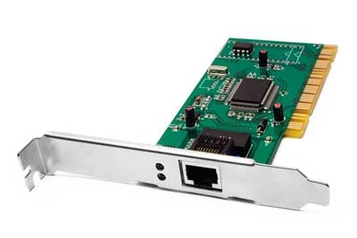

TWO TYPES OF NIC 1. INTERNAL NETWORK CARDS
In internal networks cards, motherboard has a slot for the network card where it can be inserted. It requires network cables to provide network access. Internal network cards are of two types. The first type uses Peripheral Component Interconnect (PCI) connection, while the second type uses Industry Standard Architecture (ISA).

Slide 5
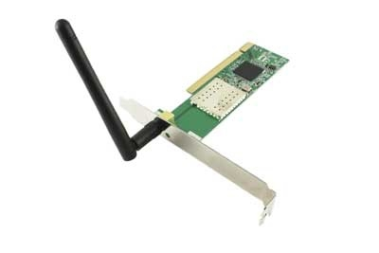

2. EXTERNAL NETWORK CARDS
In desktops and laptops that do not have an internal NIC, external NICs are used. External network cards are of two types: Wireless and USB based. Wireless network card needs to be inserted into the motherboard, however no network cable is required to connect to the network. They are useful while traveling or accessing a wireless signal.

Slide 6

Transmission Media
A communication channel that is used to carry the data from the transmitter to the receiver through the electromagnetic signals.
The main function of this is to carry the data in the bits form through the Local Area Network (LAN). In data communication, it works like a physical path between the sender & the receiver.

Slide 7
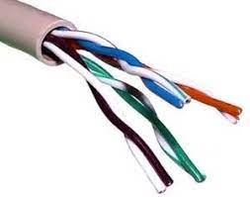
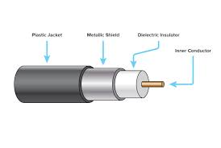
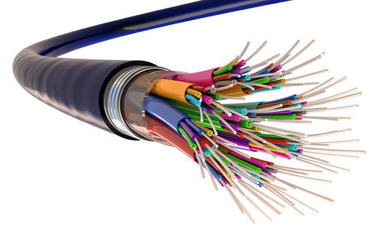

TYPES OF TRASMISSION MEDIA
1. First one is guided media which is also know as physical transmission media. (physical path needed to transmit a signal)
2. There are types of guided media which are
Twisted pairs
Coaxial cables
Fibre optic
1. Second one is unguided media which is a also known as wireless transmission media.(air path needed to transmit a signal)
2. There are so many wireless media which are
Radio
Cell phone
Microwave

Slide 8

TOPOLOGIES MEDIA
A network topology is the physical and logical arrangement of nodes and connections in a network. Nodes usually include devices such as switches, routers and software with switch and router features. Network topologies are often represented as a graph. Network geometry can be defined as the physical topology and the logical topology.

Slide 9
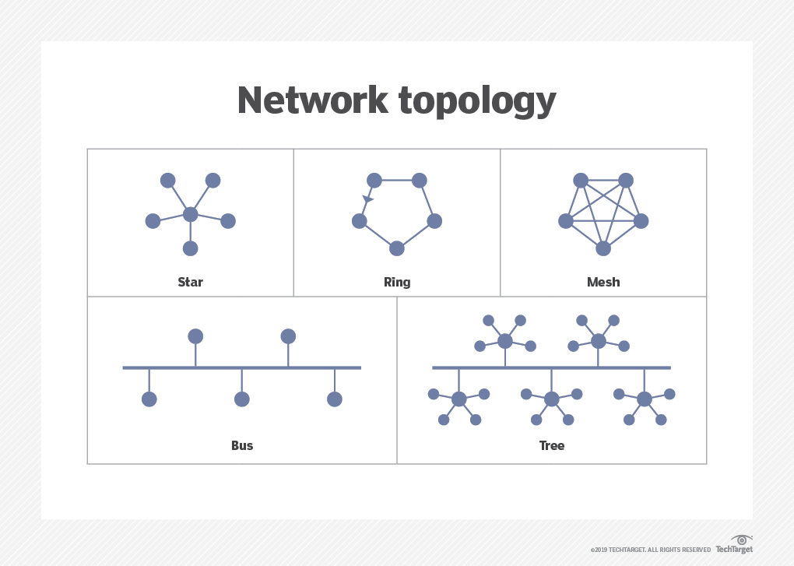

TYPES OF TOPOLOGIE

Slide 10

Crimping tools and Color standards for Straight crimping and Cross crimping
A crimping tool is a device used to conjoin two pieces of metal by deforming one or both of them in a way that causes them to hold each other. The result of the tool's work is called a crimp.
For instance, network cables and phone cables are created using a crimping tool (shown below) to join the RJ-45 and RJ11 connectors to both ends of either phone or Cat 5 cable.

Slide 11
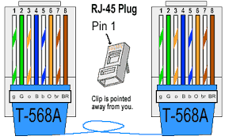
ETHERNET CABLE CORD
A straight-thru is used as a patch cord in Ethernet connections.
A crossover is used to connect two Ethernet devices without a hub or for connecting two hubs.
A crossover has one end with the Orange set of wires switched with the Greenest.

Slide 12
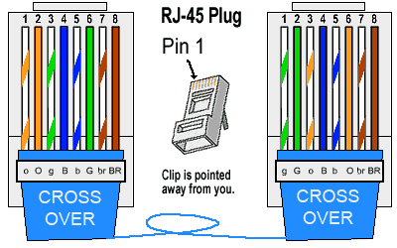
RJ -45 Crossover Ethernet Cable
A good way of remembering how to wire a Crossover Ethernet cable is to wire one end using the T-568A standard and the other end using the T-568B standard.
Another way of remembering the color coding is to simply switch the Green set of wires in place with the Orange set of wires. ● Specifically, switch the solid Green (G) with the solid Orange, and switch the green/white with the orange/white.

Slide 13

THANK YOU

